Slide 1

Thinkful Capstone project
Predicting stock market movements
Ryan Mitchell
June 25, 2017

Slide 2
Problem statement & Background
The initial goal of this capstone project was to use today’s news headlines to try to predict tomorrow’s movement (simply up or down) in the Dow Jones Industrial Average. The inspiration for this project came from a popular dataset on Kaggle (https://www.kaggle.com/aaron7sun/stocknews).
Of course, the stock market can at times be erratic and/or irrational – particularly in the short term. But many investors subscribe to the theory that the market is “efficient” in the long term. Per Investopedia.com, the efficient market hypothesis (EMH) is an investment theory that states that it is impossible to consistently "beat the market" because stock market efficiency causes existing share prices to always incorporate and reflect all relevant information.
Whether or not this theory is true is subject to great debate in the investment community. Hedge funds with billions of dollars of backing exist solely on the premise that it is possible to beat the market, but academics have published countless articles arguing the futility of trying to do so. Everyone would agree, however, that even a 1% edge over the market would lead to a significant advantage in the long term.

Slide 3
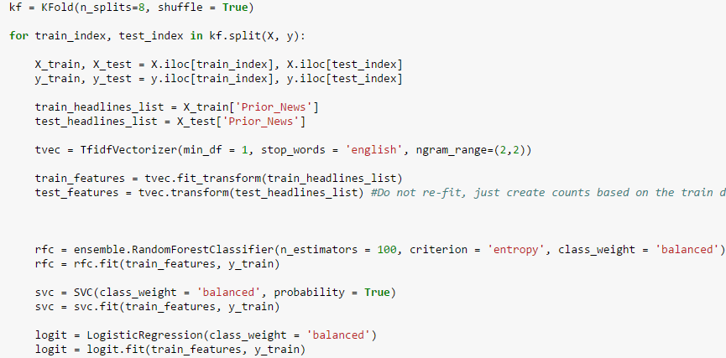

Approach 1 – Natural language processing through text vectorization
The first model I constructed made use of the Tfidf (Term Frequency Inverse Document Frequency) Vectorizer which transforms text to feature vectors to be used as model inputs. The features in this case were comprised all possible 2 consecutive-word combinations (bigrams) in the provided news headlines used for training sets, and excluded common English words like “of”, “is”, “was”, “a”, etc. The remaining bigrams were then weighted by the inverse of their frequency in the document. The output was a feature-set vector with > 300,000 elements.
By process of trial and error, I found that bigrams (2 consecutive-word combinations) produced the most reliable model outputs. However, the various binary classifier algorithms I used in this first approach (Random Forest, Support Vector Classifier (SVC), and Logistic Regression) all failed to produce results that were more accurate than a simple daily buy and sell strategy.
Accuracy of Buy & Sell Each Day Benchmark Strategy: 54.1%

Slide 4
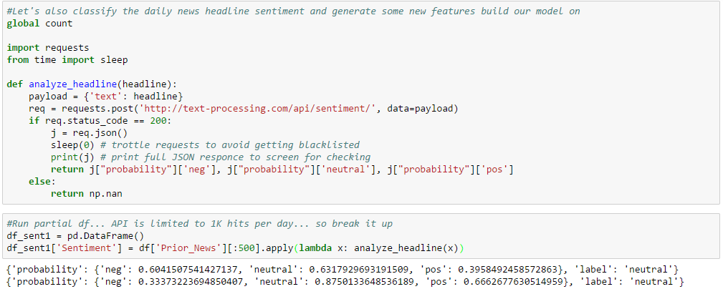
approach 2 – text sentiment Analysis
When the text vectorization approach failed to produce a model that surpassed the null accuracy, my mentor and I decided to try to try to analyze whether the sentiment of the headlines could serve as a valuable predictor for the stock market movement the following day. In pursuit of this goal, I leveraged an existing external API (from text-processing.com) designed to classify text into 3 categories: positive, negative, and neutral. The API outputs a probability for each classification, where the positive and negative probabilities sum to 1, and the neutral probability is considered separately – also on a continuous scale from 0 to 1. After classifying each day’s headlines with the API, I tried two different approaches to constructing a predictive model.

Slide 5
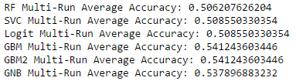
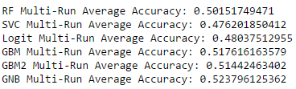
text sentiment Analysis [continued]
Method 1
Ranked the positive/neutral/negative probability scores across all observations in the dataframe, and selected the lowest rank across the 3 scores as the classification for that day.
Fit various models (Random Forest, SVC, Logistic Regression, Gradient Boosting (deviance & exponential loss functions), and Gaussian Naïve Bayes) using each day’s sentiment classification as the model predictors.
Ran 3 8-fold cross validations.
Fit a separate model using the raw positive, negative, and neutral output probabilities as features using the same models and the same testing methodology of 3 8-fold cross validations.
Unfortunately, neither method produced a model that outperformed the null (buy and sell each day) strategy (54.1% accurate).
Method 2

Slide 6
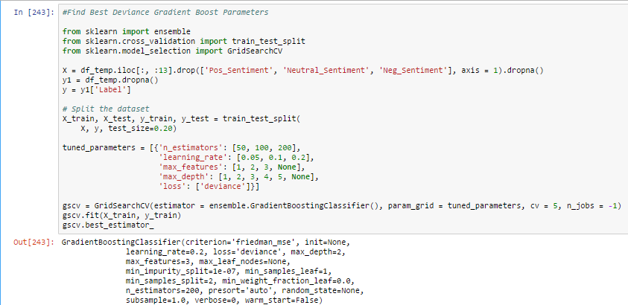
Approach 3 – technical indicators
After all other approaches failed to yield a model that outperformed a simple daily buy and sell strategy, I researched some academic publications to try to identify some indicators that others have used to predict market movements with some measure of success (please refer to http://www.cse.scu.edu/~mwang2/projects/Predict_stockMarket_16w.pdf for one example). I also included a few of my own features. The full list of the predictors used in the final model can be found in the appendix of this deck.
Just as I did before, I fit various models (Random Forest, SVC, Logistic Regression, Gradient Boosting (deviance & exponential loss functions), and Gaussian Naïve Bayes) using only the technical indicators as model predictors. Initial tests showed that the Random Forest and Gradient Boosting models worked best, so I began the process of fine-tuning the parameters for those models. In this case, I used the GridSearchCV function to identify optimal parameters such as estimator count, learning rates, loss functions, max features, and max depth.

Slide 7
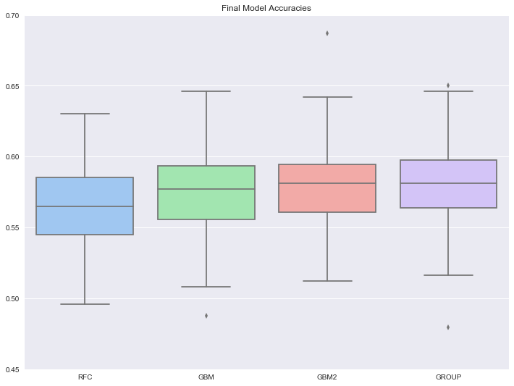

Model Evaluation – classification accuracy
The GROUP/stacked model, a simple average of the
classification probabilities of three top performing models,
produced the highest accuracy over 10 8-fold cross-
validations.

Slide 8
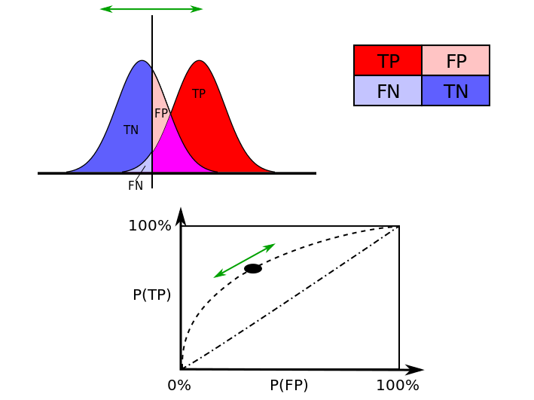

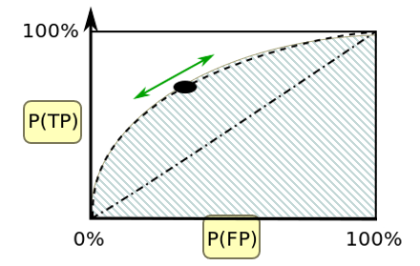

Model evaluation – Area under the ROC Curve
One common technique used to measure model accuracy of binary
classifiers is the ROC AUC (Area Under the Receiver Operating
Characteristic Curve). This metric can be thought of as the probability
that your model will rank a uniformly drawn random positive sample
above a uniformly drawn random negative sample in terms of its
likelihood of being a positive, or a 1 rather than a 0. Below is a basic
demonstration of how this value is calculated.
You start by plotting the counts of your target outcomes (positives = red,
negatives = blue) on the y-axis. The x-axis represent the model’s output probability
of the sample being a positive result. By iterating over various classification
thresholds (from 0 to 1, depicted by the vertical bar in the top image), you can
calculate a series of false positive rates and true positive rates. These rates are then
plotted as x and y coordinates to generate the ROC curve. The area under the line
at y = x represents the probability of a correct ranking of a random positive sample and
a random negative sample by chance alone (AUC = 50%).
True Positive Rate = Correctly Predicted Positives / All Positives
False Positive Rate = False Positives / All Negatives
False Negative Rate = False Negatives / All Positives
True Negative Rate = Correctly Predicted Negatives / All Negatives

Slide 9
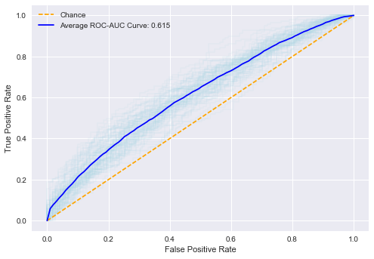
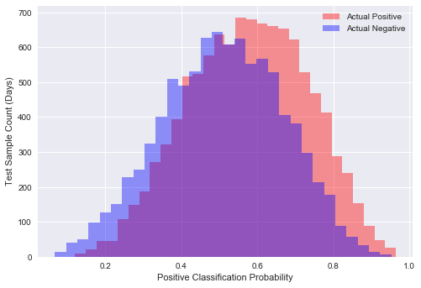
Model evaluation – Area under the ROC Curve
The GROUP model discussed earlier also produced the highest average AUC score (0.615).
Using 10 8-fold cross-validations, I generated and plotted 80 ROC curves, as well as the average of those 80 curves.
I also plotted true and false positives in those 80 cross-folds by the final model’s positive classification probability output.
Although there is significant overlap between the positive and negative classes, there is also a noticeable rank-ordering.

Slide 10
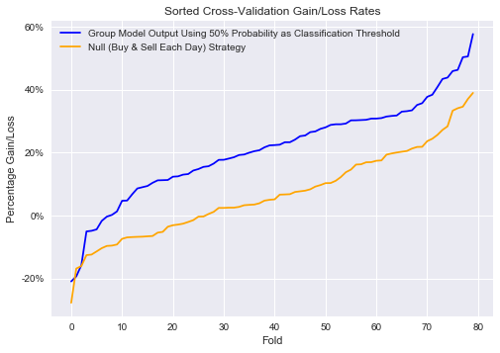
SIMULATED returns on Cross validations
Methodology
To calculate the “group” model gains, start by comparing the predicted and actual outcomes each day. If the model produced the correct output, add the absolute value of the market change to a running total. If the model was wrong, subtract the absolute value of the daily change from the running total.
To calculate the null strategy (buy at open and sell at close) gains, simply take the difference between open and close prices for the day and add that number to a separate running total.
Finally, divide each running total by the average open price over the test time periods (this is our “average cost”) and rank order the returns for easier visualization.

Slide 11
Appendix – technical indicators explained
Prior Day Trading Volume (Number of Shares Bought/Sold)
Prior Day Percentage Change
Prior Day Up/Down Indicator
Prior Day Price Differential from 21-Day Moving Average
Prior Day Price Differential from Bollinger Bands (21-Day Moving Average +/- 2*Rolling 21-Day Standard Deviation)
Williams Percentage Range (WPR) Calculated Over 14-Days: [(Highest High – Prior Closing Price) / (Highest High – Lowest Low)] * -100
Rate of Change (ROC): [(Prior Close – Prior Close 2 periods ago) / (Prior Close 2 periods ago)] * 100
Commodity Channel Index (CCI): (Typical Price - 20-period SMA of Typical Price) / (.015 x Mean Deviation)
Typical Price = (Prior High + Prior Low + Prior Close)/3
Constant = .015
Mean Deviation = There are four steps to calculating the Mean Deviation. First, subtract the most recent 20-period average of the typical price from each period's typical price. Second, take the absolute values of these numbers. Third, sum the absolute values. Fourth, divide by the total number of periods (20).
Relative Strength Index (RSI) = 100 - 100 / (1 + RS)
RS = Exponential Weighted Moving Average gain of up periods during the specified time frame /
Exponential Weighted Moving Average loss of down periods during the specified time frame (14 days)

